Slide 1
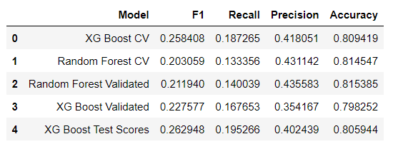
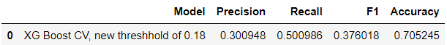
Predicting Waze User Churn
The Machine Learning Model
Project Overview
The overall business goal of this project is to help prevent user churn on the Waze app. This project focuses on monthly user churn. This project will analyze user data and develop a machine-learning (ML) model that predicts user churn. At this stage we constructed and tested several ML models.
●We built and tested two ML models to predict churn status: Random Forest (RF) and XG Boost (XGB).Recall score was our main evaluation criteria.
●XGB has the best predictive power among logistic regression and RF models considered.
● However, even this model does not predict churn very well. The recall score with the test data was only 19.5%. Therefore there is a need to improve the model.
● Changing the default decision threshold (which is 50%) for classification is one way to improve the model. If a predicted probability is above the threshold then the model assigns churn status for a user.
●Reducing classification decision threshold to 18% significantly increased recall and f1 scores, but decreased precision and accuracy scores.
●Top 5 important feature in the champion model are: km_per_hour, total_sessions_per_day, percent_sessions_in_last_month, n_days_after_onboarding and km_per_drive.
●Type of users’ device does not seem to be strongly associated with churn, which is consistent with our findings during the previous EDA.
Evaluation Metrics for the Considered Models
Evaluation Metrics for the XGB model with the lowered classification decision threshold
While the XGB model can be useful to identify relationships between the churn status and user characteristics, it is not a very good model for the prediction. The following steps can be taken to improve it:
1. Conducting further hyperparameter tuning.
2. Increasing sample size, including by finding the missing churn status values.
3. Balancing the data since the dataset is moderately imbalanced.
4. Adding some more features that are likely to be correlated with the churn status (like whether users' geographic area is a heavy-trafficked urban area or not or car ownership)

